Slide 1
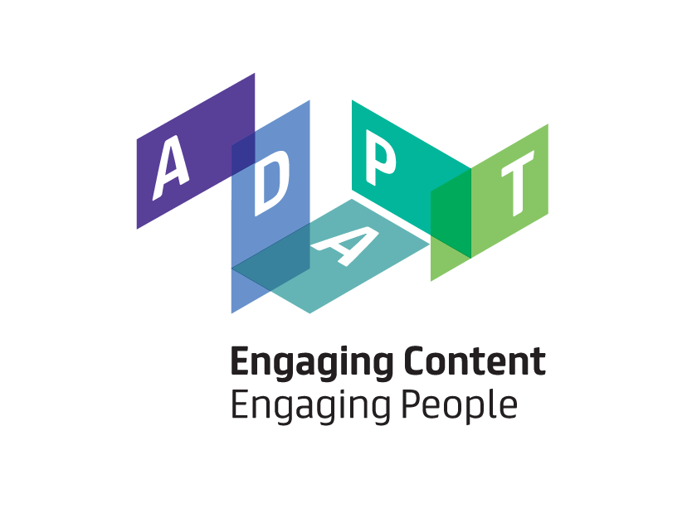
Enhancing Data Use Ontology (DUO) for Health-Data Sharing by Extending it with ODRL and DPV
Harshvardhan Pandit, ADAPT - Dublin City Uni., Ireland
Beatriz Esteves, Uni. Ghent – imec, Belgium

Slide 2
Agenda
Introductions
Our understanding of DUO and DUC/CCE
What is the Data Privacy Vocabulary (DPV)?
What is the Open Digital Rights Language (ODRL)?
Using ODRL and DPV to improve DUO + DUC/CCE
Next Steps / Going Forward
Refer to: Enhancing Data Use Ontology (DUO) for Health-Data Sharing by Extending it with ODRL and DPV by H. J. Pandit and B. Esteves. Semantic Web Journal (2024) https://doi.org/10.3233/SW-243583

Slide 3
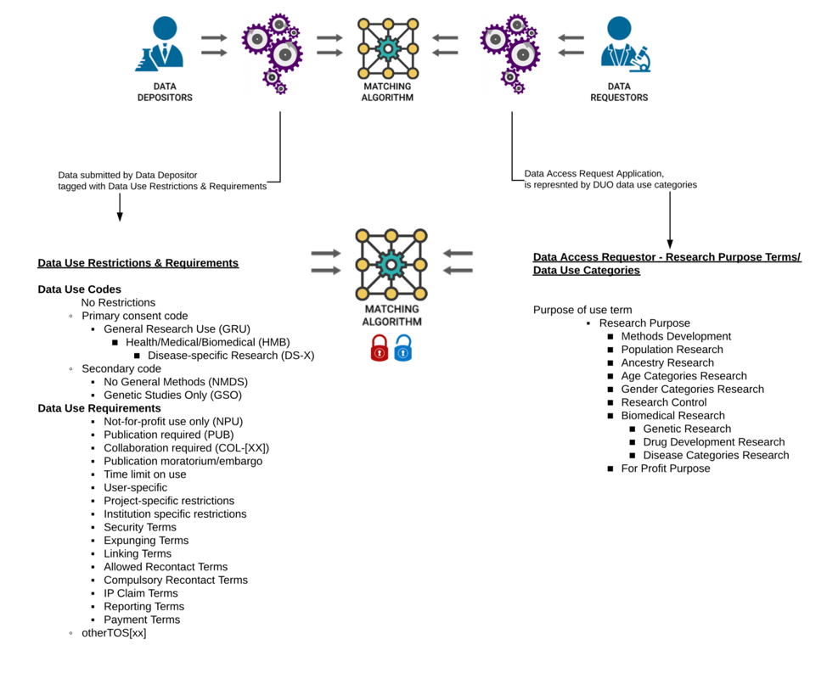
DUO - Data Use Ontology
The (GA4GH) Data Use Ontology (DUO) includes terms describing data use conditions, particularly for research data in the health/clinical/biomedical domain.
Datasets are annotated with semantic information using DUO, and then this is used to 'match' available data with requests using the matching algorithm
This workflow and modelling is based on practical needs of organisations involved
http://purl.obolibrary.org/obo/duo

Slide 4
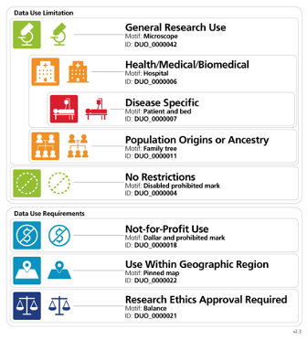
Data Use Ontology (DUO)
DUO aims to define:
- permissions e.g. use data for X
- prohibitions e.g. don't do Y
- constraints e.g. do Z after X
These 'rules' are defined using DUO concepts to create "Data Use Limitations" (DUL) for datasets
DUO uses OWL (so it is semantic-aware) and is linked to OBO
DUO and DULs have both machine- and human-readable meaning e.g. code for machine and text for humans

Slide 5
DUC/CCE for creating "data sharing policies"
Common Conditions of Use Elements (CCE): – a controlled vocabulary representing concepts for use in data sharing policies
atomic i.e. each term should represent a single concept
no directionality i.e. term should not specify if reuse or sharing is allowed, forbidden, etc.
generalised i.e. term should be modular category without conditionality, or dependencies
the term should be “widely applicable and relevant”.
Digital Use Conditions (DUC) – a policy expression mechanism to specify rules regarding conditions for sharing and reuse of datasets
a condition term, which is a CCE concept;
a rule, which is one of Obligatory, Permitted, Forbidden, and No Requirement;
a scope, which is either ‘Whole of asset’ by default or ‘Part of asset’; and
optionally a condition parameter with an optional value.

Slide 6
Challenges in using DUO + DUC/CCE
Lacking a formal specification and basis in standards means the onus is on the community to define 'every little thing' necessary for interoperable communication and interpretation
how to express different 'concepts' e.g. disease, publishing, organisation type = non-profit
how to express and interpret 'conditions' e.g. permission and prohibition within each other
how to 'use' this information e.g. check conditions have been satisfied in the future
Not linked to regulations - which vary across jurisdictions
e.g. EU GDPR has specific requirements for 'notice' and 'consent'
e.g. EU DGA enables data reuse through intermediaries
e.g. US/UK regulations may have opt-outs
These are the same challenges also faced in 'regtech' by organisations, so what existing solutions can we reuse to help GA4GH in its mission?

Slide 7
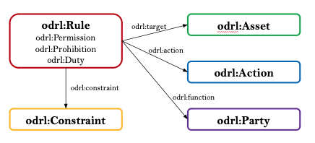
Open Digital Rights Language (ODRL)
W3C Recommendation
Maintained by the W3C ODRL Community Group
Composed by several specifications
ODRL Information Model – W3C Recommendation
ODRL Core Vocabulary – W3C Recommendation
ODRL Implementation Best Practices
ODRL Profile Best Practices
ODRL Formal Semantics [Under development]
Easily extendable through the use of ODRL profiles

Slide 8
Aligning DUO concepts with ODRL
Concept | Code | Rule Type | Constraint | Placeholder
DUO0000001 | Data Use Permission
DUO0000006 | HMB | Permission | Purpose is :HMB and not :POA
DUO0000007 | DS | Permission | Purpose is :DS and mondo:0000001 | :TemplateDisease
DUO0000017 | Data Use Modifier
DUO0000020 | COL | Duty | Action is :CollaborateWithStudyPI
DUO0000016 | GSO | Prohibition | Purpose is :GS and not :GSG
DUO0000022 | GS | Permission | Spatial is equal to specified :Location | :TemplateLocation
OBI0000066 | Data Use Permission
DUO0000034 |  | Permission | Age is specified :Age | :TemplateAgeCategory
DUO0000040 |  | Permission | Purpose is :DS and mondo:0000001 | :TemplateDisease

Slide 9
Aligning CCE with ODRL
CCE Term | DUO Term | DPV/ODRL Mapping
Use As Control | Research Control | dpv:Purpose
Clinical Research Use | Biomedical Research | dpv:Purpose
Geographical Area + Permitted | Geographical restriction | dpv:Location
Research Use + Permitted | General research | dpv:Purpose
Clinical Care Use + Permitted | Clinical Care Use | dpv:Purpose
Return Of Results + Obligated | Return to database or resource | dpv:Data + dpv:Recipient + odr:Obligation
Collaboration + Obligated | Collaboration required | dpv:Purpose + odrl:Obligation

Slide 10
Enhancing DUO with ODRL
odrl:Set = conditions
odrl:Offer = offer to use data
odrl:Request = request to use data
odrl:Agreement = approved request with one or more offers
Permission = allowed
Prohibition = not allowed
Obligation = MUST be done
Duty = MUST be done after something
Constraints can be any triple
<subject> <relation> <object>

Slide 11
Proof of Concept: matching offers with requests
DUO term | Constraint | Offer | Rule | Request | Decision | Reason
GS | Location | Spain | Permission | Europe | DENY | Europe ⊈ Spain
GS | Location | Europe | Permission | Spain | GRANT | Spain ⊆ Europe
GS | Location | Spain | Prohibition | Europe | DENY | Europe ∩ Spain ≠ ∅
GS | Location | Europe | Prohibition | Spain | DENY | Spain ∩ Europe ≠ ∅
GS | Location | UK | Prohibition | Spain | GRANT | Spain ∩ UK = ∅
GRU | Purpose | HMB | Permission | DS-Cancer | GRANT | DS-Cancer ⊆ HMB
GRU | Purpose | DS-Cancer | Prohibition | HMB | DENY | HMB ∩ DS-Cancer ≠ ∅

Slide 12
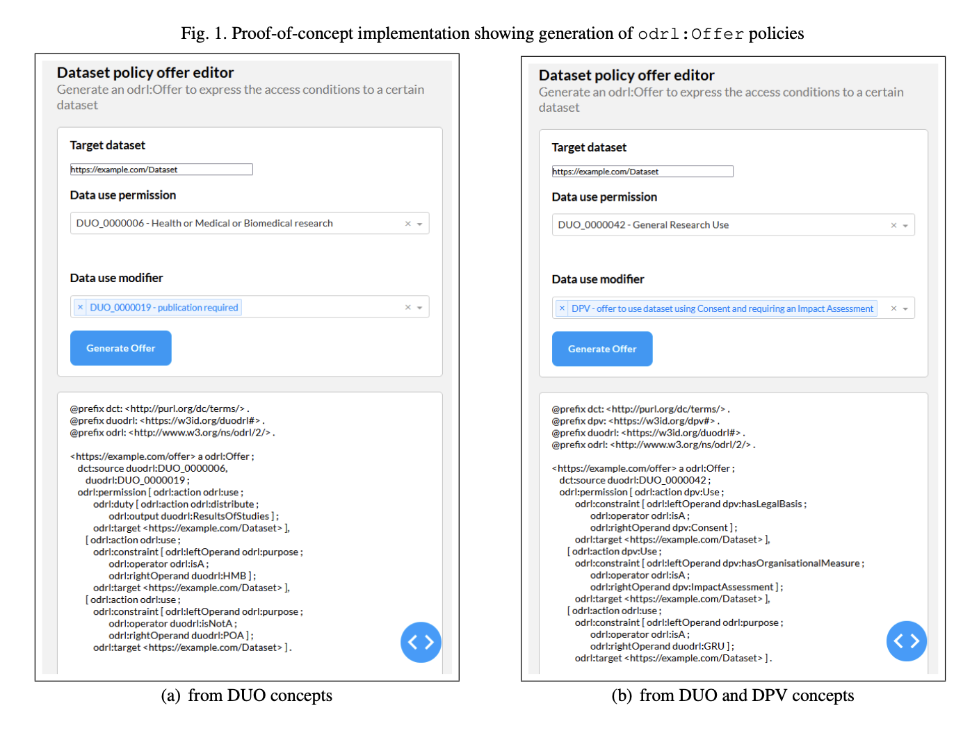
Proof of Concept
GUI interface
https://w3id.org/duodrl/repo

Slide 13
Benefits of ODRL
Using ODRL solves the challenges for having a standardised representation
It is a W3C standard - so we have interoperability and consistency
All tools can use the information in the same manner
We have a good way to define how datasets should be represented (odrl:Offer) and requests (odrl:Request) and do the matching between them (odrl:Agreement)
Remaining challenge: Where do we get the concepts like purpose, consent, and the legal stuff from? → DPV!

Slide 14
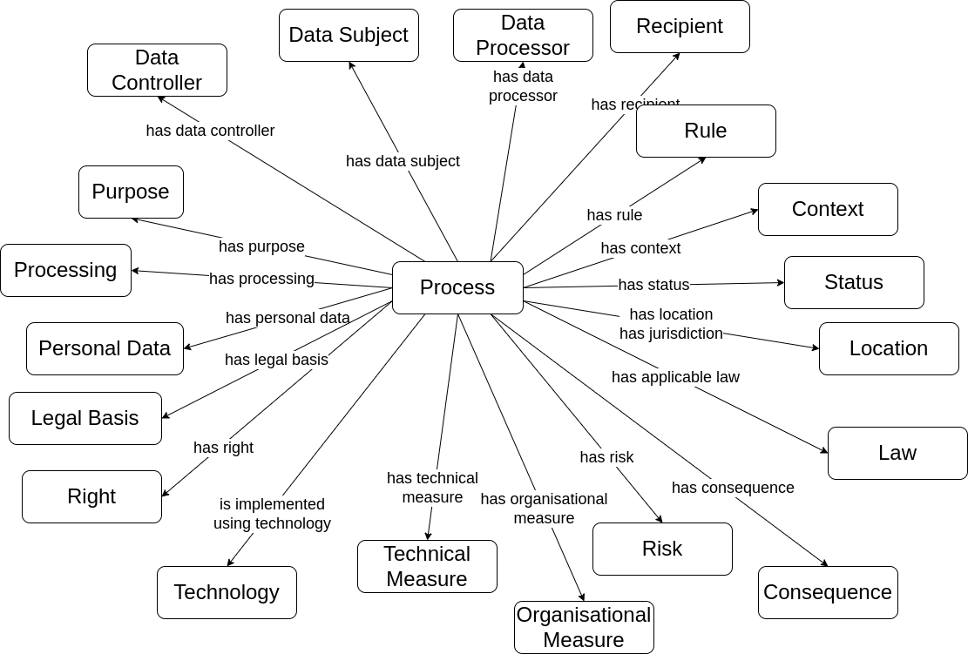
Data Privacy Vocabulary (DPV)
Developed by the W3C Data PRivacy Vocabularies and Controls Community Group (DPVCG)
Defines an 'ontology' for defining how data and technologies are used
Provides 'taxonomies' for using the concepts in practical use-cases

Slide 15
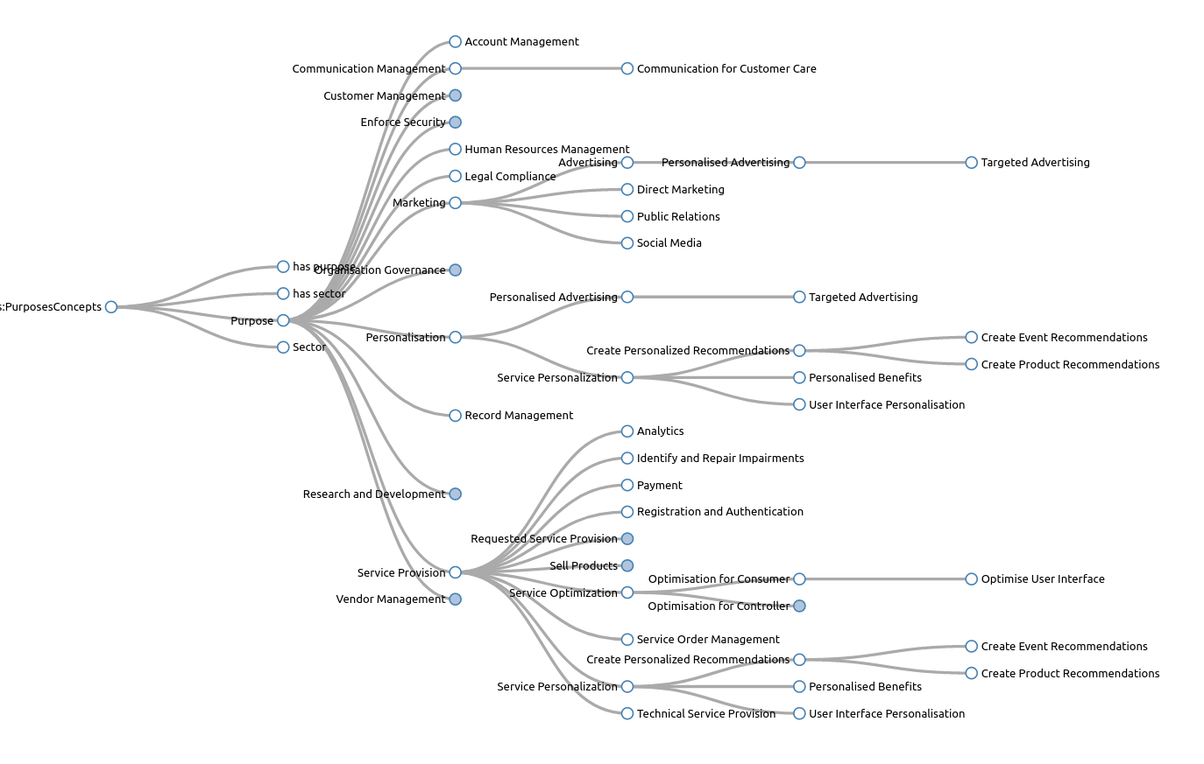
DPV Taxonomies
DPV provides rich hierarchical trees in top-down fashion that go from abstract to more specific concepts
E.g. Purpose taxonomy
Purpose → Service Provision Service Provision → Service Personalisation Service Personalisation → Personalised Benefits
generated by SKOSPlay https://skos-play.sparna.fr/

Slide 16
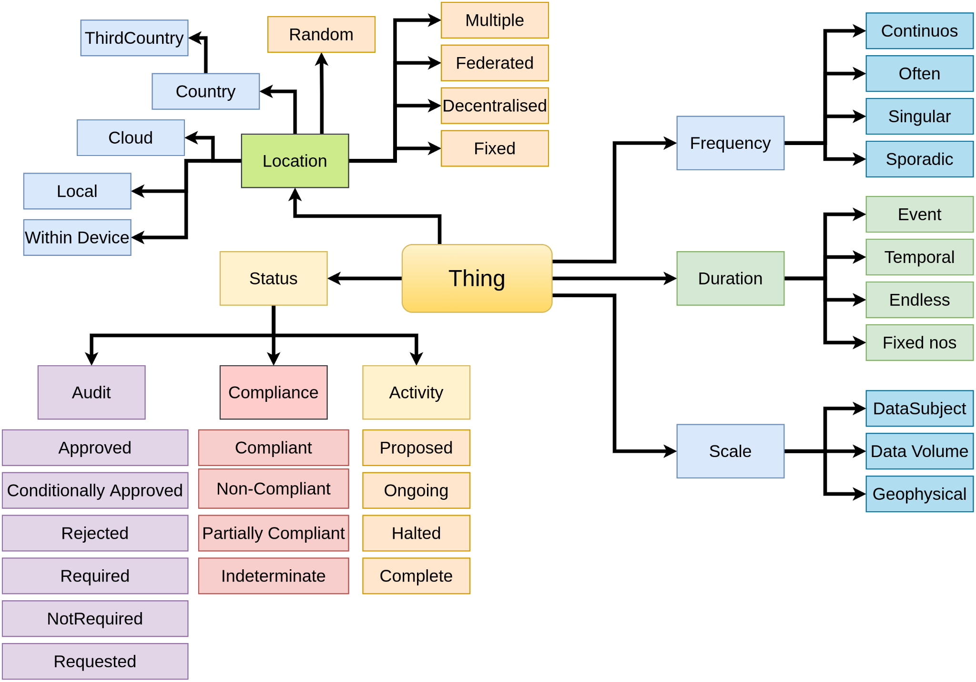
Contextual Information
Duration
Scale
Frequency
Status
Audits
Compliance
Location
Jurisdiction
Adequacy Decisions
Data Source
Automation
Storage conditions
Decision Making
Human Involvement
Consequences & Impacts

Slide 17
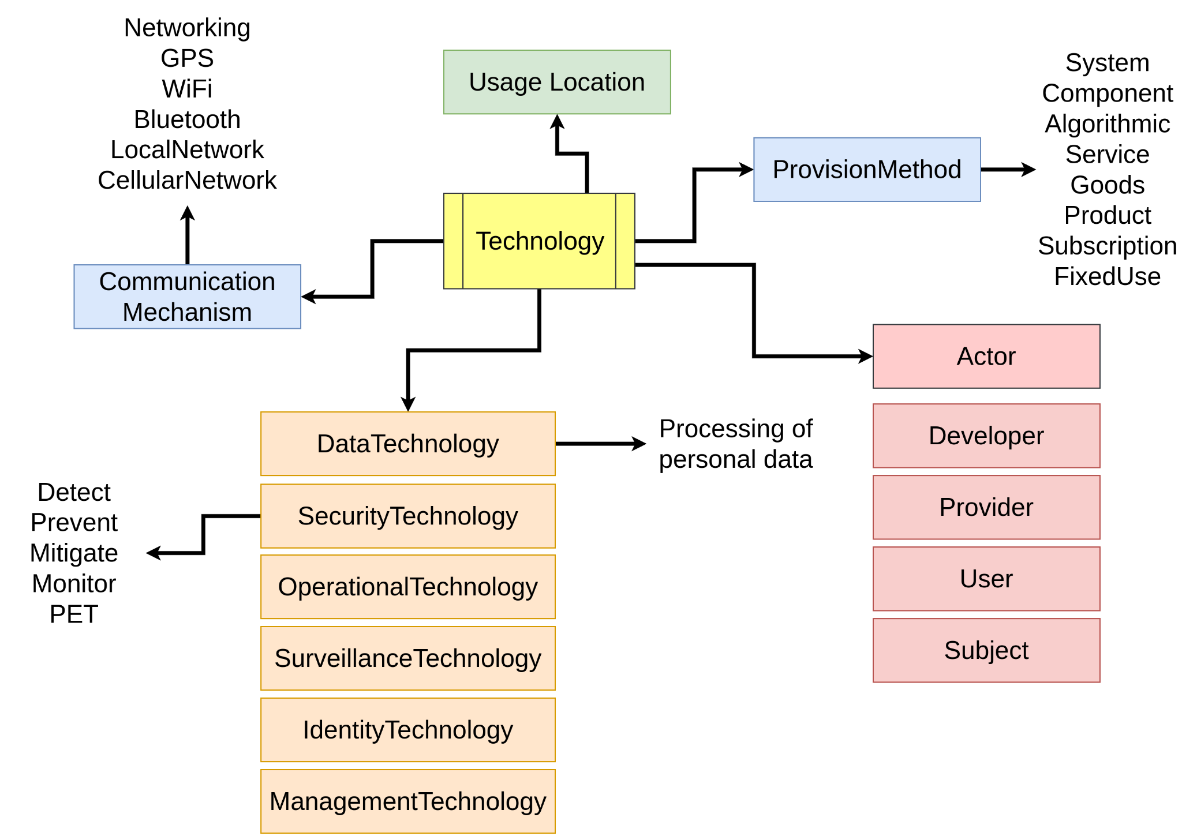
Technologies and Implementations
"Technology" is how you implement a process.
It can be a service, tool, or a system you develop, reuse, or purchase from a vendor.
Representing them is important to provide practical knowledge about personal data and its processing.
how do we specify use of data when "AI technologies" are involved?

Slide 18
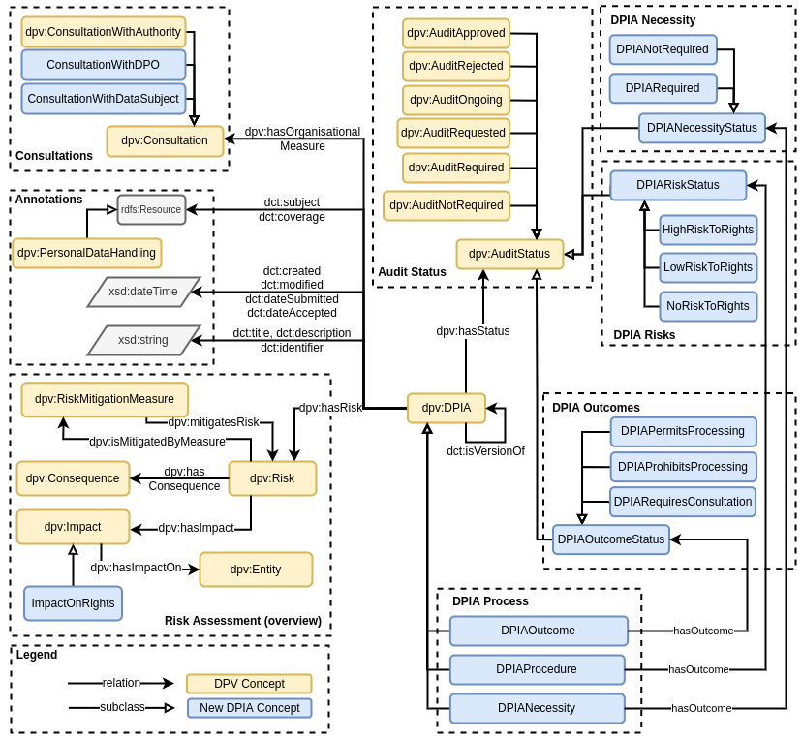
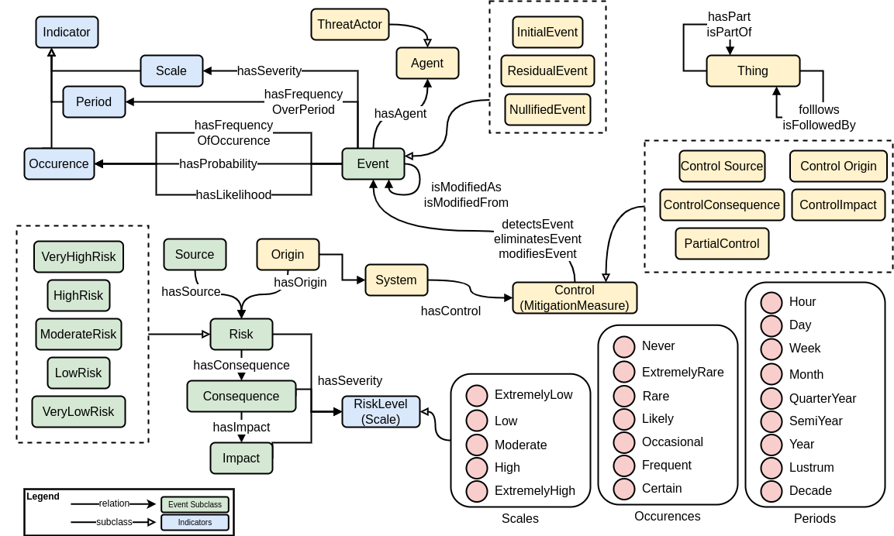
Using DPV for DPIA and Risk Assessments

Slide 19
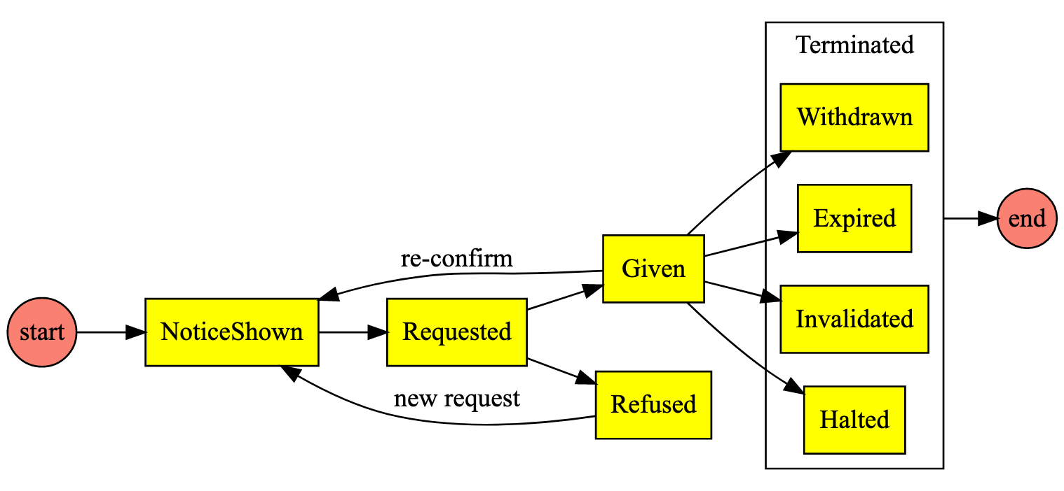
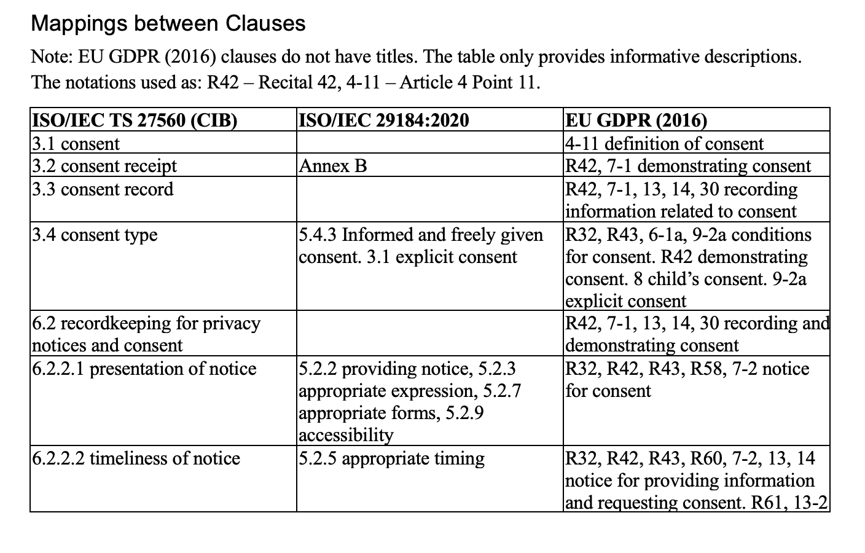
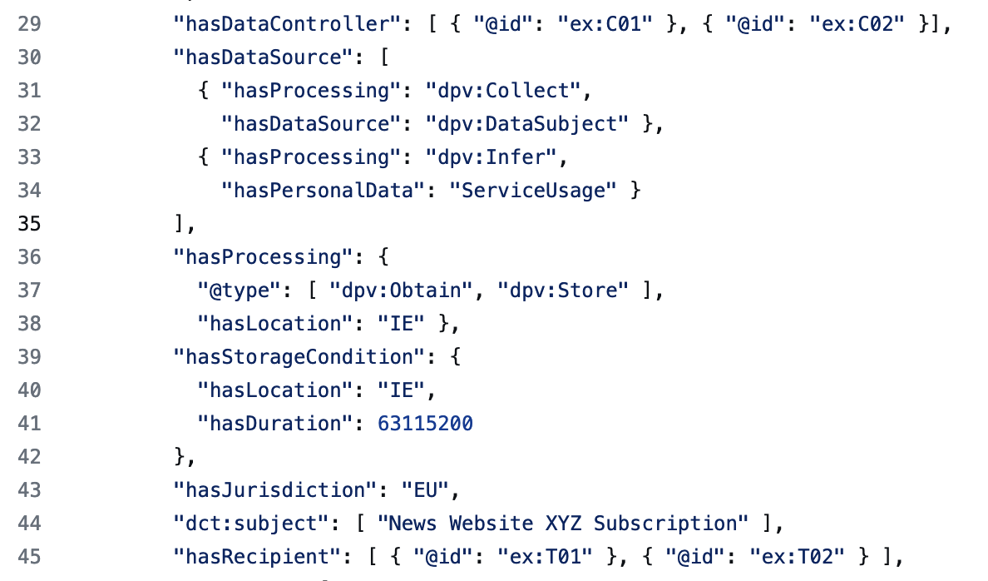
Maintaining consent records using DPV based on ISO/IEC TS 27560:2023
(2) records are maintained for legal obligation and also organisation's needs, we map ISO with GDPR
(1) consent has a 'legally relevant' lifecycle
(3) tools and automation requires information in interoperable and machine-readable form

Slide 20
Pan-Jurisdictional KG

Slide 21
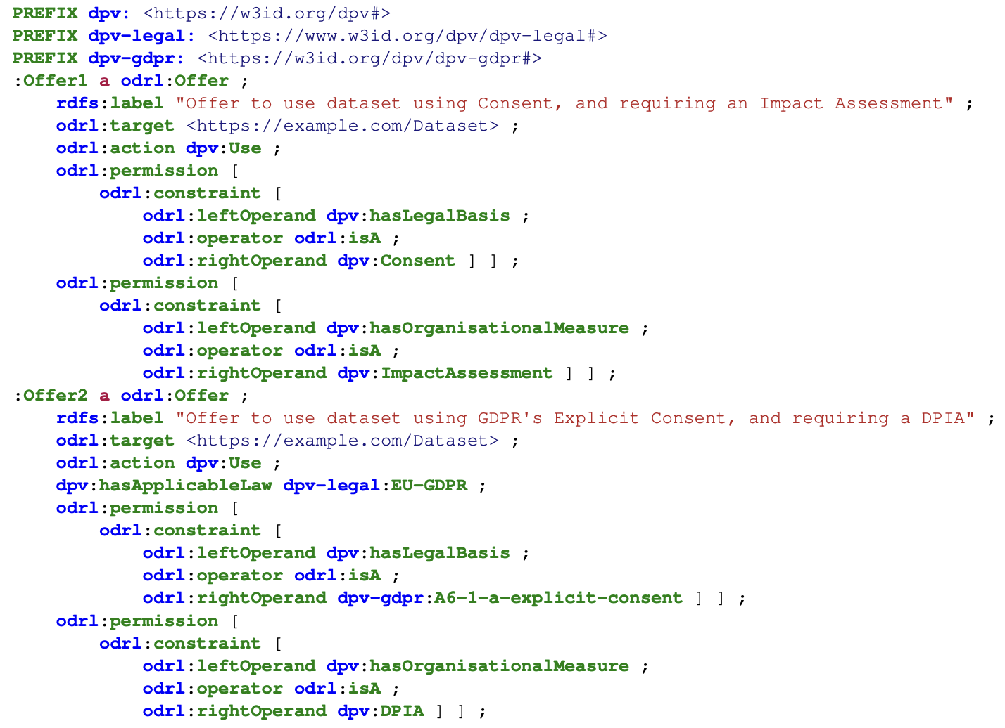
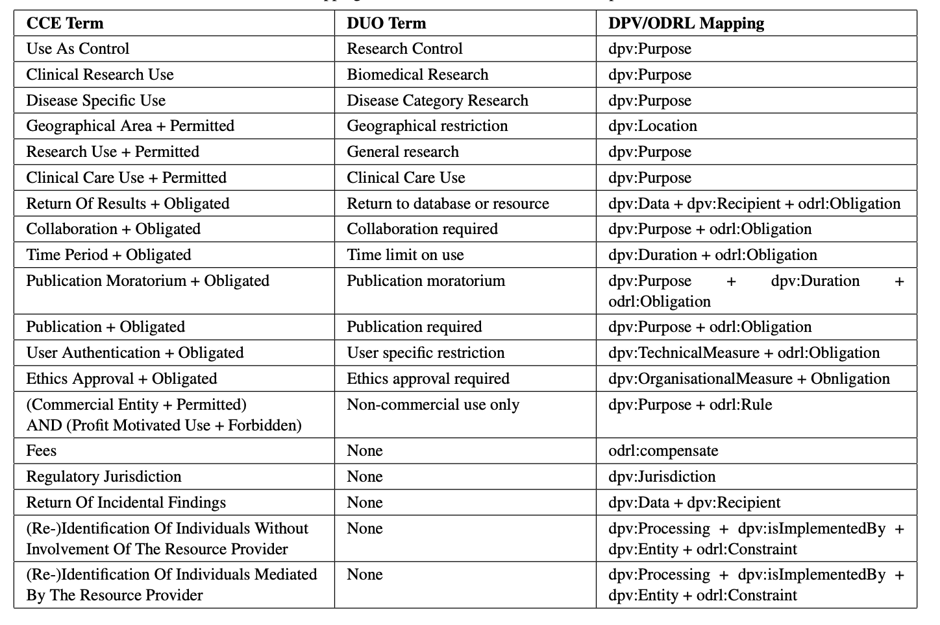
Enhancing DUO with ODRL and DPV

Slide 22
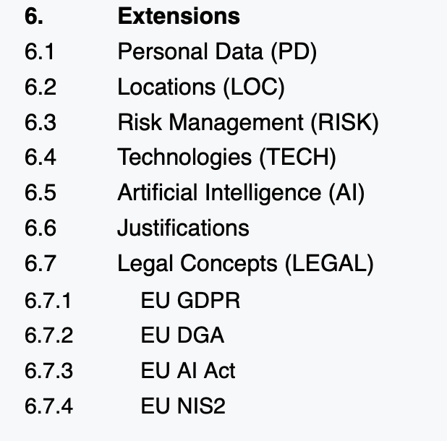
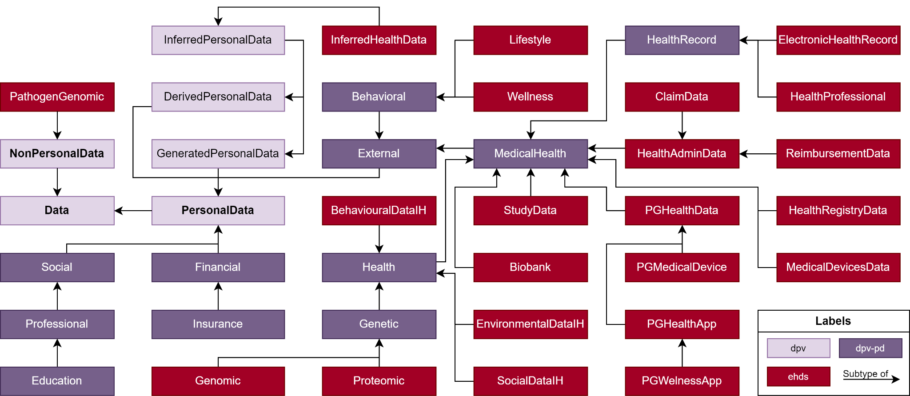
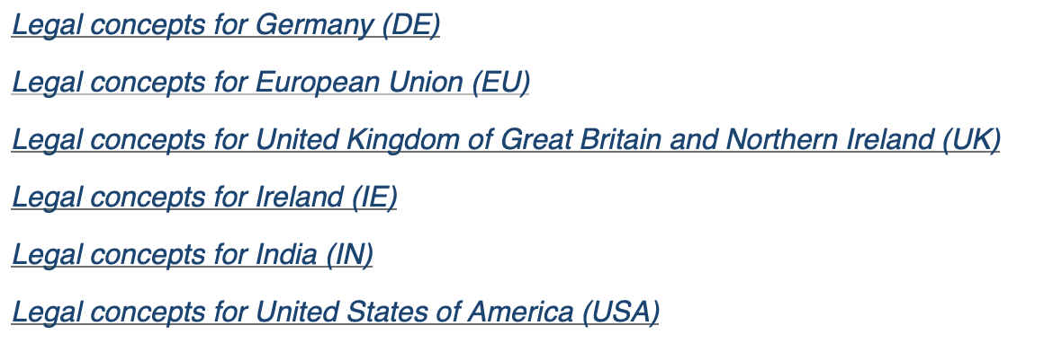
What about Health Data Spaces?

Slide 23
In conclusion… does everything need to change?
Not necessary. DUO and CCE/DUC can be 'mapped' to ODRL + DPV as we have shown to keep existing uses consistent
Future developments can utilise ODRL+DPV in various ways
Providing a way for legal compliance with ODRL+DPV is a net benefit for the 'disruption' in change - and also has long term advantages
DUO and CCE/DUC can be continued as a 'wrapper' around ODRL+DPV defined policies

Slide 24
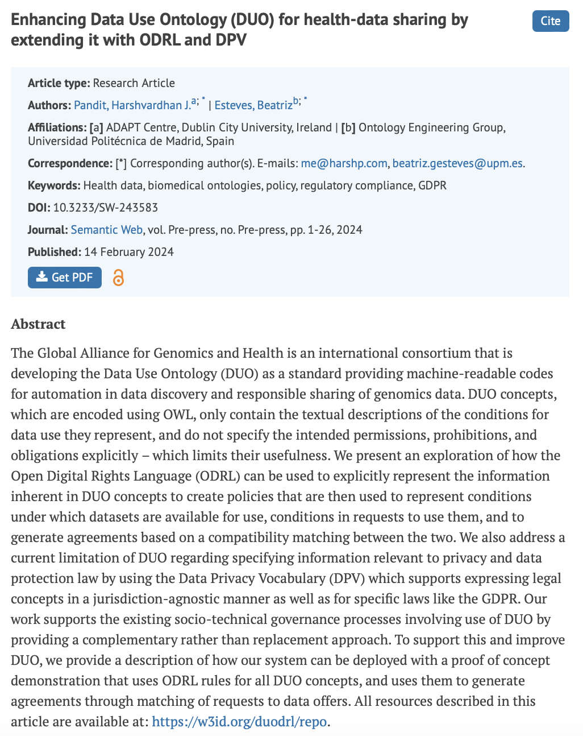
Read our paper for more info!
Enhancing Data Use Ontology (DUO) for Health-Data Sharing by Extending it with ODRL and DPV by H. J. Pandit and B. Esteves. Semantic Web Journal (2024) https://doi.org/10.3233/SW-243583

